Slide 1
LG Boost Regressor
- Light Gradient Boosting
Predicts continuous values by minimizing a loss function (e.g., Mean Squared Error)
Effective for regression tasks and can handle both structured and unstructured data.

Slide 2
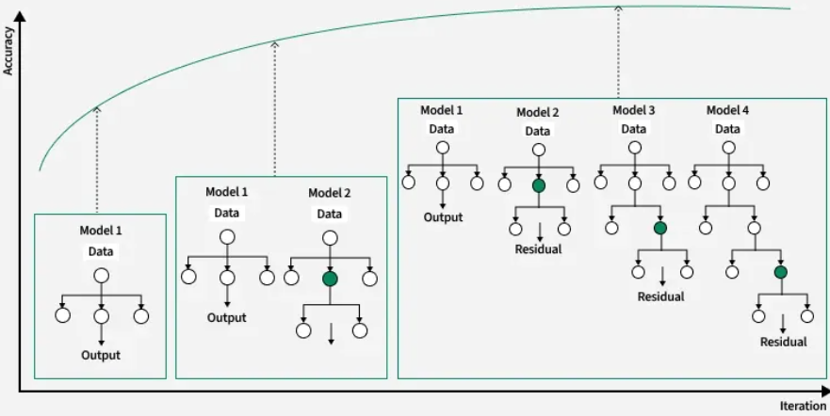
LG Booster – Pictorial Representation

Slide 3
Derivation of R value with different parameters (Verified for Insurance predictor dataset)
Boosting Type | N_estimators | Max_depth | Random state | R value
gbdt | 100 | -1 | 42 | 0.866
gbdt | 50 | -1 | 100 | 0.876
Gbdt | 10 | -1 | 200 | 0.785

